Slide 1
FunSeq2: a framework for prioritizing noncoding regulatory variants in cancer
Fu et al, 2014 Genome Biology 15:480
Critical paper review by
Jasleen Grewal

Slide 2
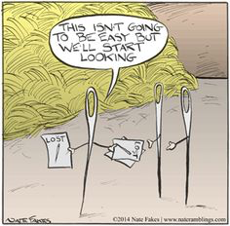
The hunt is on…
DNA damage is at the root of
Hereditary diseases
Cancer formation and evolution
Millions of single nucleotide polymorphisms
(Hundreds of) thousands of single nucleotide variants per tumour sample
Average mutation rate per normal cell division = 1.1
Acquisition of mutations
Primary (driver)
Passenger
Looking for causal variants is not an easy job!

Slide 3
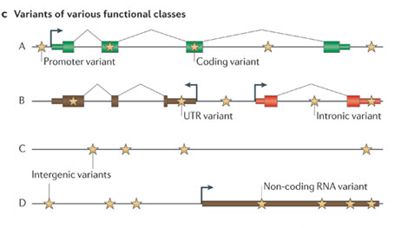
But it’s a proteomics world!
Mutations can occur in
Protein coding regions
Non-protein coding regions
98% of our genome!
Intronic
Regulatory (bind Transcription Factors)
ncRNA
Pseudogenes, repeats, telomeres
ENCODE results: >80% of our DNA has biochemical activity
1. Needles in stacks of needles: finding disease-causal variants in a wealth of genomic data. Nature Reviews Genetics 12, 628-640 (September 2011) | doi:10.1038/nrg3046

Slide 4
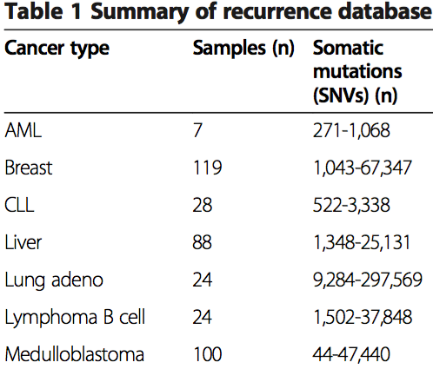
NGS data = lots of data
Prioritizing variants is important and directly relevant to the study of genetic diseases with a high mutational load
Protein-coding mutations
ncRNAs
Mutations in regulatory regions
Regulate gene expression levels
Immune system (MHC Class II promoters)
Largely ignored in GWAS studies
Effect prediction is challenging
Notes:
http://www.hindawi.com/journals/mbi/2014/967565/

Slide 5
Prioritizing non-coding regulatory variants
Build a compendium of ranked variants (‘Data Context’)
Regions: ENCODE, 1000 Genomes, HOTS, GERP score
Variants: Cancer WGS
Genes: TCGA, ICGC, COSMIC
Networks: PPI, ChIP-Seq, RNA-Seq
Data Context
Evolutionarily Conserved Regions
Variant Information
Gene and network annotations
Frequency of mutation (Recurrence DB)
- 570 samples
- COSMIC

Slide 6
Prioritizing non-coding regulatory variants
Get user’s variant dataset, and prioritize against built data context (use weighted scoring scheme)
Variant Prioritization
Data Context
User Cancer Variants

Slide 7
Scoring non-coding regulatory variants
What are the potential regulatory sequences?
Get annotated transcription factor binding sites, enhancers, promoters, methylation sites
What does the variant do in the sequence?
Loss of function (motif breaker)
Gain of function (motif gain, new binding site?)
Has the region been conserved traditionally?
GERP score – conservation over species
1000 genomes project – evolutionarily constrained regions in human populations
What does the site regulate?
Neighborhood genes and validated interactions/regulation
Role of gene in the cell (network centrality)
1. Functional Annotation of Putative Regulatory Elements at Cancer Susceptibility Loci. Cancer Inform. 2014; 13(Suppl 2): 5-17.
Notes:
In particular, alleles associated with late-onset conditions may not exhibit evolutionary constraint as they have modest, quantitative effects in disease risk.

Slide 8
Scoring non-coding regulatory variants
What are the potential regulatory sequences?
Get annotated transcription factor binding sites, enhancers, promoters, methylation sites
What does the variant do in the sequence?
Loss of function (motif breaker)
Gain of function (motif gain, new binding site?)
Has the region been conserved traditionally?
GERP score – conservation over species
1000 genomes project – evolutionarily constrained regions in human populations
What does the site regulate?
Neighborhood genes and validated interactions/regulation
Role of gene in the cell (network centrality)
1. Functional Annotation of Putative Regulatory Elements at Cancer Susceptibility Loci. Cancer Inform. 2014; 13(Suppl 2): 5-17.
Notes:
In particular, alleles associated with late-onset conditions may not exhibit evolutionary constraint as they have modest, quantitative effects in disease risk.

Slide 9
Scoring non-coding regulatory variants
What are the potential regulatory sequences?
Get annotated transcription factor binding sites, enhancers, promoters, methylation sites
What does the variant do in the sequence?
Loss of function (motif breaker)
Gain of function (motif gain, new binding site?)
Has the region been conserved traditionally?
GERP score – conservation over species
1000 genomes project – evolutionarily constrained regions in human populations
What does the site regulate?
Neighborhood genes and validated interactions/regulation
Role of gene in the cell (network centrality)
1. Functional Annotation of Putative Regulatory Elements at Cancer Susceptibility Loci. Cancer Inform. 2014; 13(Suppl 2): 5-17.
Notes:
In particular, alleles associated with late-onset conditions may not exhibit evolutionary constraint as they have modest, quantitative effects in disease risk.

Slide 10
Scoring non-coding regulatory variants
What are the potential regulatory sequences?
Get annotated transcription factor binding sites, enhancers, promoters, methylation sites
What does the variant do in the sequence?
Loss of function (motif breaker)
Gain of function (motif gain, new binding site?)
Has the region been conserved traditionally?
GERP score – conservation over species
1000 genomes project – evolutionarily constrained regions in human populations
What does the site regulate?
Neighborhood genes and validated interactions/regulation
Role of gene in the cell (network centrality)
1. Functional Annotation of Putative Regulatory Elements at Cancer Susceptibility Loci. Cancer Inform. 2014; 13(Suppl 2): 5-17.
Notes:
In particular, alleles associated with late-onset conditions may not exhibit evolutionary constraint as they have modest, quantitative effects in disease risk.

Slide 11
Resultant scoring method
Coding region variants (cis regulation) | Noncoding region variants (trans regulation)
Non-synonymous mutation? | Motif breaking/making score
Selection pressure on gene? | Region (ultra) sensitive/conserved?
Mutation is recurrent in cohort? GERP score > 2 Gene is a network hub?

Slide 12
Next step
Have an annotated, scored set of variants
Have a recurrence database
Compare each of the input variants to the dataset, and prioritize variants

Slide 13
Validation
Comparative tools
CADD – Combined Annotation Dependent Depletion. SVM model based on features from previous genome wide annotations.
GWAVA – Genome Wide Annotation of Variants.
Regulatory cancer variants (somatic)
TCGA + ICGC cancer cohorts
COSMIC regulatory somatic variant annotations (can discuss after presentation)
Germline pathogenic variants
Human Gene Mutation Database (HGMD)
Human inherited diseases – 5700 genes

Slide 14
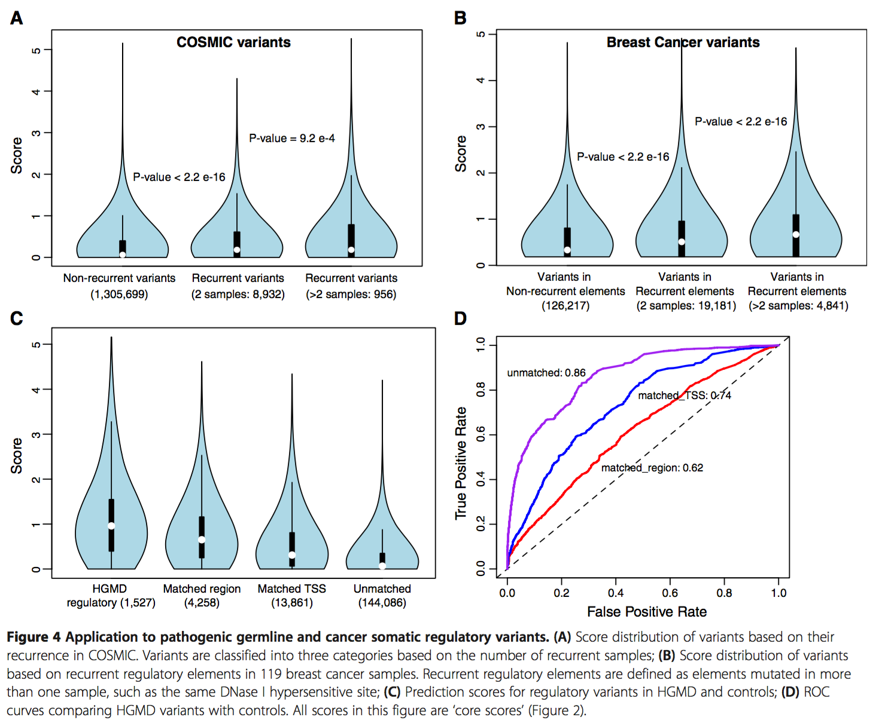
Results – cancer variants
Take 1
Figure 4. Score distribution of variants based on their recurrence in COSMIC and 119 breast cancer samples.

Slide 15
Results – cancer variants
Figure S6. Comparison of GWAVA and CADD using Breast Cancer set

Slide 16
Validation
Regulatory cancer variants (somatic)
TCGA + ICGC cancer cohorts
COSMIC regulatory somatic variant annotations (can discuss after presentation)
Germline pathogenic variants
Human Gene Mutation Database (HGMD)
Human inherited diseases – 5700 genes
Comparative tools
CADD – Combined Annotation Dependent Depletion. SVM model based on features from previous genome wide annotations.
GWAVA – Genome Wide Annotation of Variants.

Slide 17
Results – germline variants
Ranked HGMD variants higher than the controls
Hence, the prioritization works
Figure 4. Prediction scores for regulatory elements in HGMD and controls

Slide 18
Drawbacks
Prioritization o– what? Oh look, score distributions!
Comparison with other tools is hand wavy
using only 2 TERT variants to prove ‘we are better’
Only show results from large cancer datasets (with relatively lower average mutational load)
Unsatisfactory treatment of results for germline pathogenic variant ranking
Role of regulatory elements in hereditary diseases is more well studied
β-thalassemia, hemophilia and atherosclerosis¹
‘We called variants, variants’
1. Cis regulatory mutations in human disease. Brief Funct Genomic Proteomics 2009 Jul; 8(4): 310–316
Notes:
β-thalassemia, hemophilia and atherosclerosis. beta-chain of hemoglobin (HBB); coagulation Factor IX and low-density lipoprotein receptor (LDLR), respectively.
Firstly, they are less frequent than coding mutations.
Secondly, cis-regulatory mutations result in a significant reduction in target gene transcription in the relevant cell type (erythrocytes/HBB, liver/Factor IX, liver (primarily)/LDLR). Thirdly, each of the regulatory mutations alters the DNA sequence of a transcription factor-binding site that impairs the recruitment of a key transcription factor required for RNA polymerase II (pol II)-dependent synthesis of mRNA transcripts

Slide 19
Important considerations
Driver mutations may vary across tumours
Such drivers will not show recurrence across samples
Option to not add extra weight for cohort-wide recurrence (of mutation, or regulatory element)
Recurrence based method may also not be as successful in small sample sizes
Generated a ‘recurrence database’ to support annotations

Slide 20
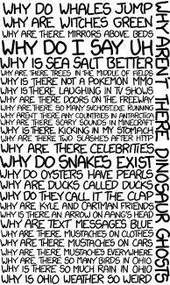
Questions?

Slide 21
Future directions
Validation with new target regulatory mutations
TERT, PLEKHS1, WDR74, SDHD¹
Other tools for comparison
Segway implements a dynamic Bayesian network method using the aforementioned biofeatures (ChIP-seq and DHS signals) to identify patterns associated with transcription start sites, gene boundaries, enhancers, and other transcription regulators in an unsupervised approach.
Studying kataegis (regions of hypermutation)
Associated with somatic rearrangement events
APOBEC family
1. Genome-wide analysis of noncoding regulatory mutations in cancer. Nature Genetics 46, 1160–1165 (2014)

Slide 22
Results – cancer variants
Take 2 (using recurrence database)
1 Medulloblastoma sample (only 2/100 samples had TERT mutations)
2183 somatic SNVs
Ranked TERT promoter mutation 2nd
Other methods were just oh so bad….
Comparative tools
CADD – Combined Annotation Dependent Depletion. SVM model based on features from previous genome wide annotations.
GWAVA – Genome Wide Annotation of Variants. Random Forest approach

Slide 23
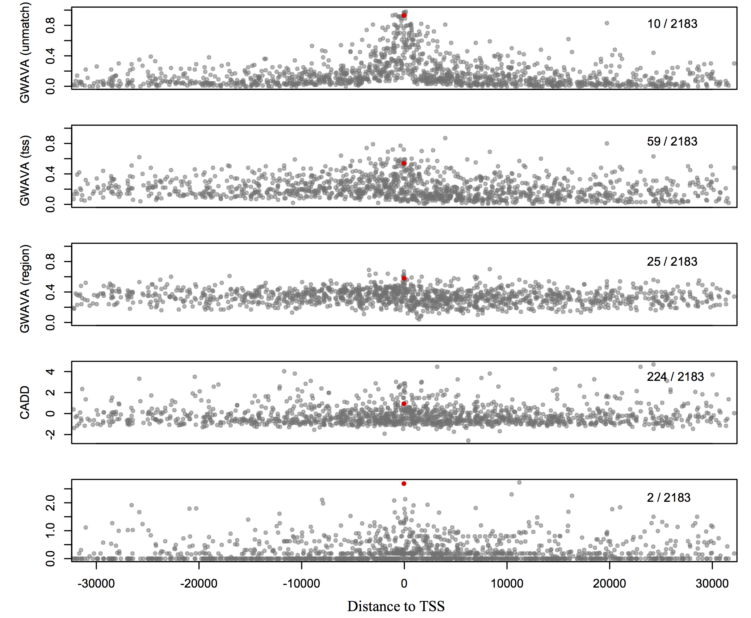
Figure S10. Relationship between distance to TSS and prediction scores (using variants from one Medulloblastoma sample - MB59). Red dot is the TERT promoter mutation. Authors reported ‘matched region’ model of GWAVA for all analysis, as the model is less prone to bias.

Slide 24
Non-coding regulatory variants
Cis-
Located on same DNA strand as the gene
Promoters, enhancers, silencers
Trans-
DNA sequences that encode transcription factors

Slide 25
Methylation sites
There are three histone modification marks that are particularly informative for the identification of most active enhancer and promoter regulatory regions, namely H3k4me1, H3k27ac, and H3k4me3. The H3k4me1 histone mark is associated with enhancers downstream of transcription start sites, and the H3k27ac signal is similarly thought to enhance transcription. Alternatively, the H3k4me3 mark is associated with active promoters.¹
1. Functional Annotation of Putative Regulatory Elements at Cancer Susceptibility Loci. Cancer Inform. 2014; 13(Suppl 2): 5-17.

Slide 26
GERP score
Genomic Evolutionary Rate Profiling
Identify slowly evolving regions in an MSA
Nucleotide constraint score
Provides enrichment for deleterious causal mutations
Allows quantitative ranking of candidates
Usually places known causal genes at/near top of candidate lists

Slide 27
GWAVA
Predicts functional impact of non-coding genetic variants
Uses ENCODE/GENCODE annotation of non-coding elements, alongwith genome wide evolutionary conservation and GC content data

Slide 28
CADD
Ranking of mutation (tolerated or deleterious) by >60 tools, using CADD score
Train SVM based on the ranking
*simulated data to represent possible de novo mutations in humans, that may’ve occurred but were not fixed in the human population.

Slide 29
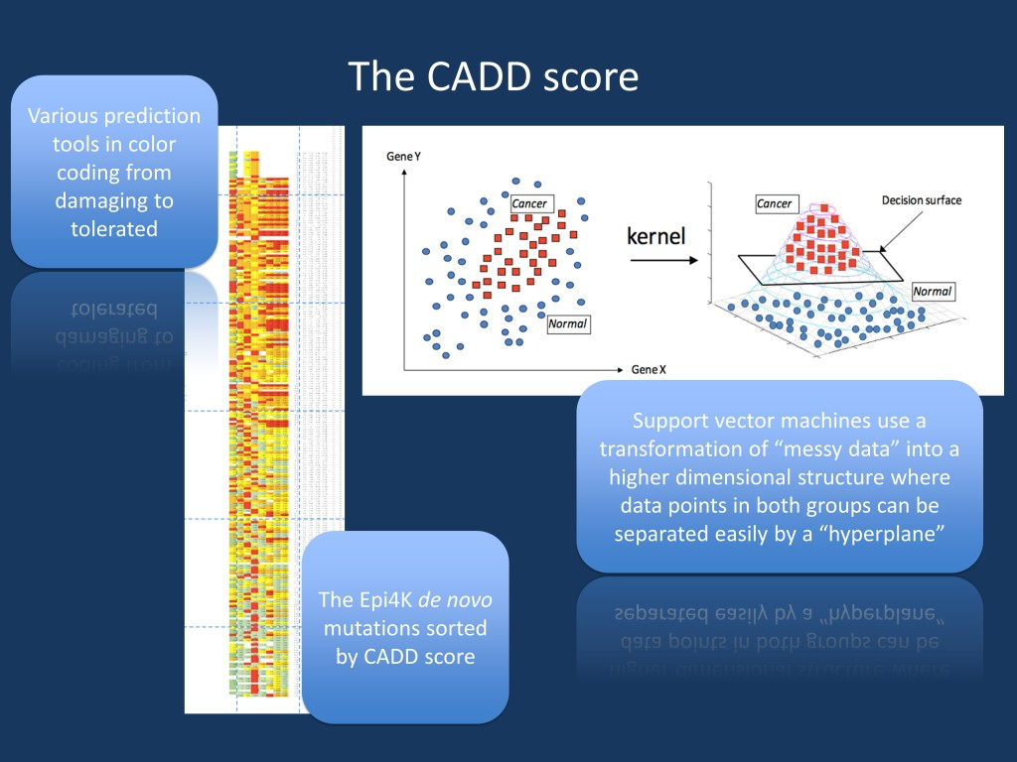

Slide 30
ENCODE
Encyclopedia of DNA Elements
Goal – determine role of non-protein coding regions of the human genome
90% of disease-associated SNPs are in non-coding regions
Identified novel DNA regulatory elements

Slide 31
Roadmap epigenomics project
This study uses it to link prioritized variants with target genes
Establish an expansive resource of epigenomic maps of normal cells and tissue phenotypes
Annotate regulatory non-coding elements

Slide 32
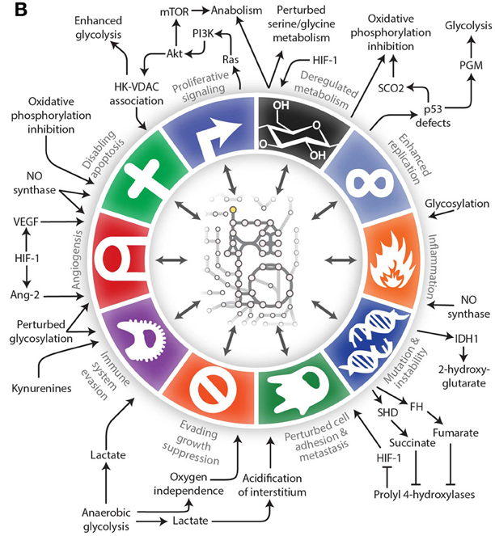
More than one way to skin a cat
1. The evolution of genome-scale models of cancer metabolism. Front. Physiol., 03 September 2013.

Slide 33
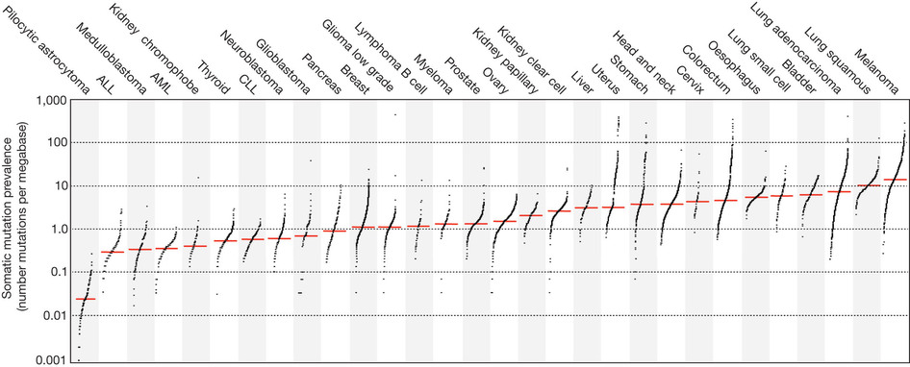
Signatures of mutational processes in cancer. Nature 500, 415–421 (22 August 2013)

Slide 34
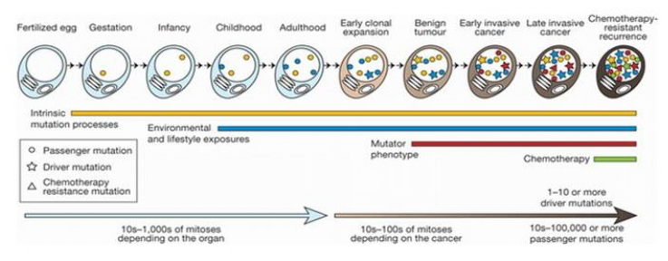
What is causal, what is a carrier

Slide 35
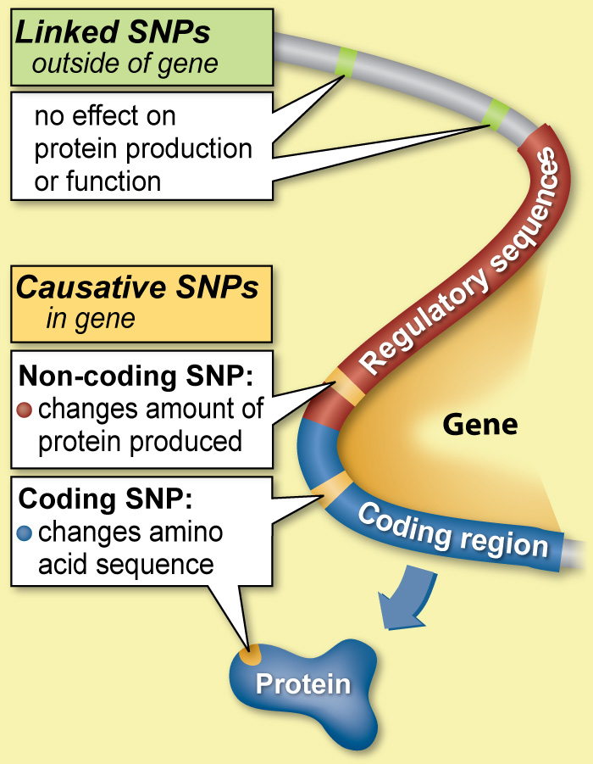
Point mutations (single nucleotide)
SNPs: Most common variants (in >= 1% of population)
One every 300 nucleotides
SNVs:
Rarer
Somatic SNVs
Unique to the tumour
Spontaneous point mutations

